Slide 1
ParkSmart
Computer vision based parking system

Slide 2
TABLE OF CONTENTS
1
2
3
1
1
1
Introduction
Dataset
Methods
4
5
1
1
Preliminary Results
Next steps

Slide 3
Introduction
Our goal is to develop a machine learning model to identify occupied and empty parking lots, as well as count available spaces
Significance
Parking is a struggle for students and staff at KSU. Searching for parking spots without any technology leads to frustration, wasted time, and traffic congestion.
Input & Output:
• Input: Drone footage of parking lots at various times, CarTopView Dataset, survey data from students.
• Output: Data analysis, sentiment analysis, detected occupancies, and empty spots count.

Slide 4
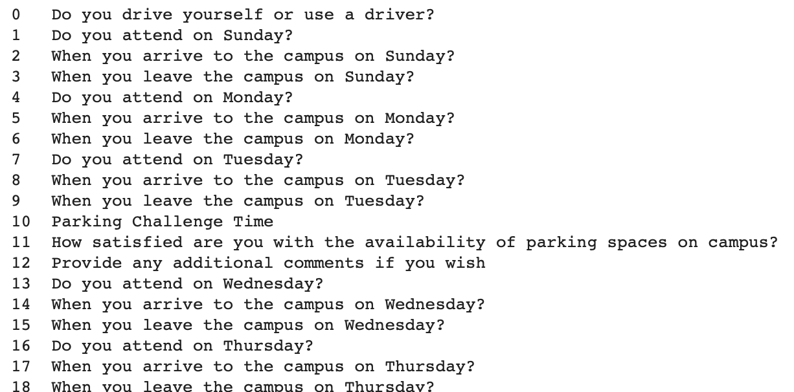
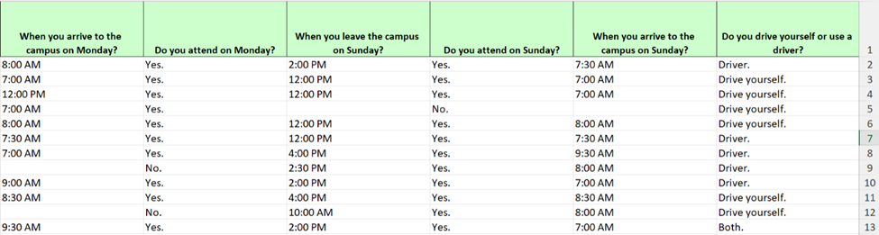
Dataset
1- Survey
- Conducted a survey targeting students who use gate3 and received 115 responses.
- The survey has 18 questions, 15 aimed to understand the attendance patterns
throughout the week.
The responses were all
nominal, except the satisfaction rate with the parking which is ordinal, and times of arrival/departure which are interval

Slide 5
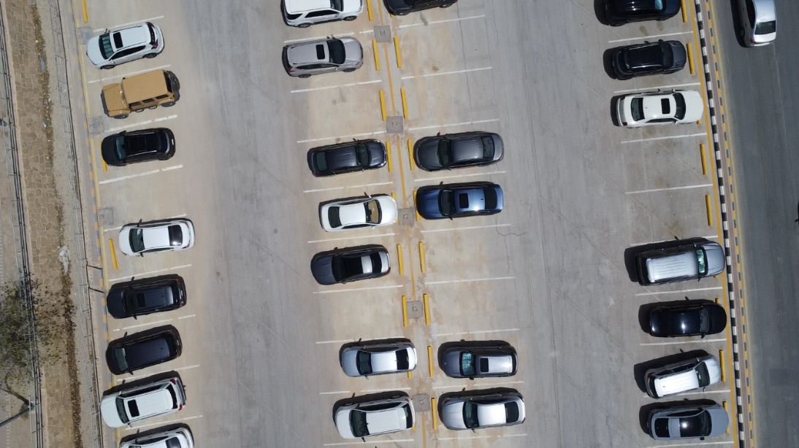
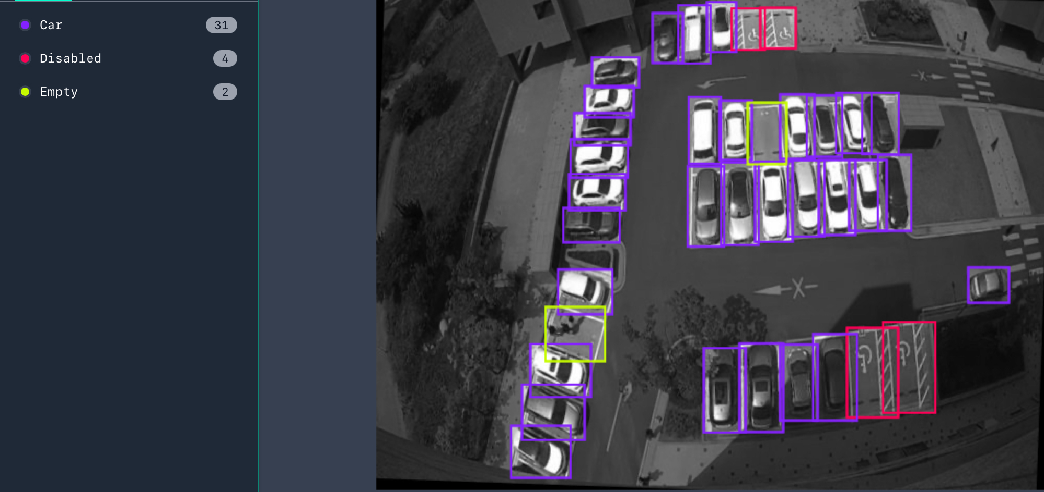
Dataset
2- Gate3 parking lot videos
1-Manually collected 2 videos of the parking lot using a drone, with 19 minutes and 48 seconds total duration, 35,580 total frames
1- CarTopView Dataset:
Roboflow dataset with 2571 Total Images (2412 Train, 109 Validation, 56 Test).
It has 3 classes; Car, Empty, and Disabled.

Slide 6
Methods
Exploring the problem through the survey
We performed Sentiment Analysis on the comment's column
using a pre-trained model from Hugging Face called
"bhadresh-savani/distilbert-base-uncased-emotion”.
This model can pick up on a range of emotions, including joy, sadness, anger, fear, and more.

Slide 7
Methods
Gate3 parking lot videos
1- Pretrained Single Shot Multibox
Detector (SSD):
resized frames to fit model requirements
Detect and draw bounding boxes on the detected objects for visual feedback.
Evaluated by using average precision, average recall, approximate F1 score performance metrics
2- YOLO11n:
pretrained (COCO) model
Trained on CarTopView Dataset with Gridearch to find the best learning rate and epoch

Slide 8
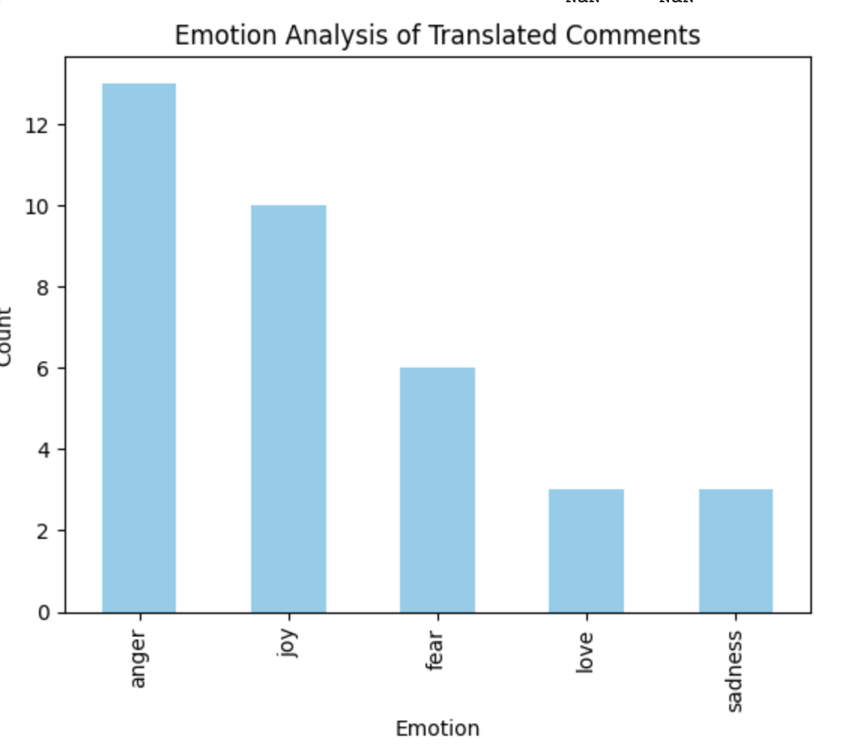
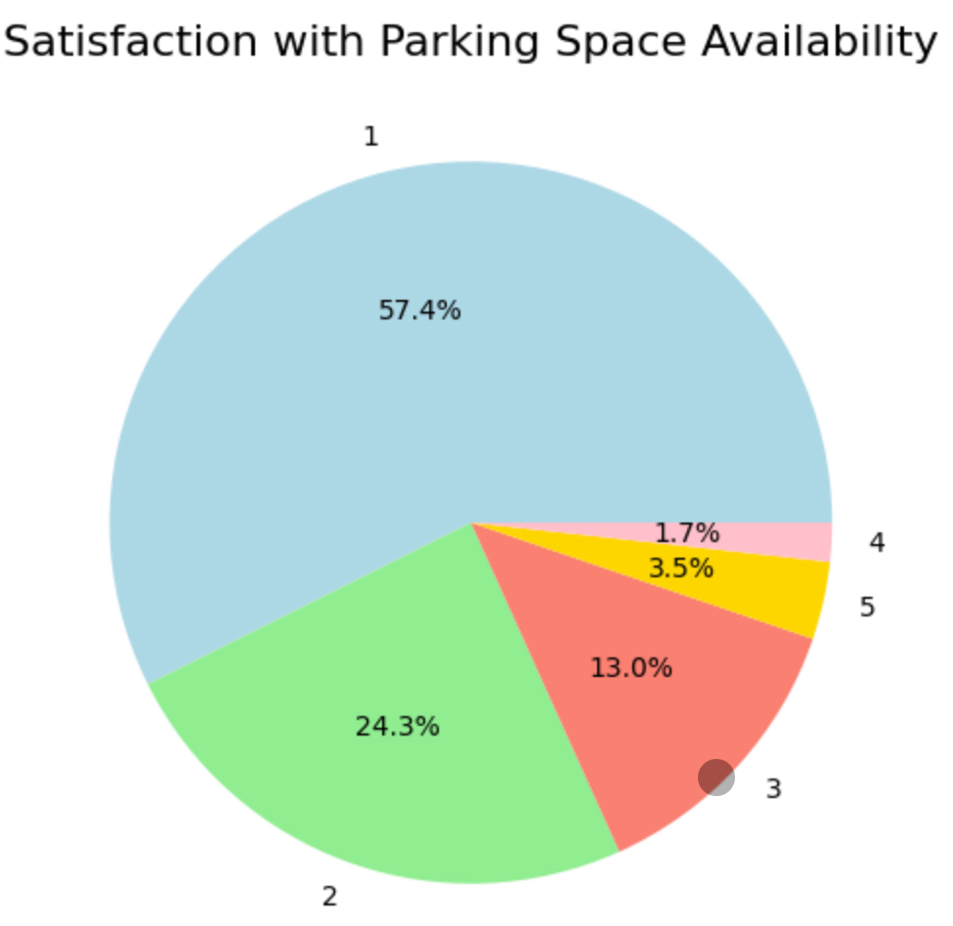
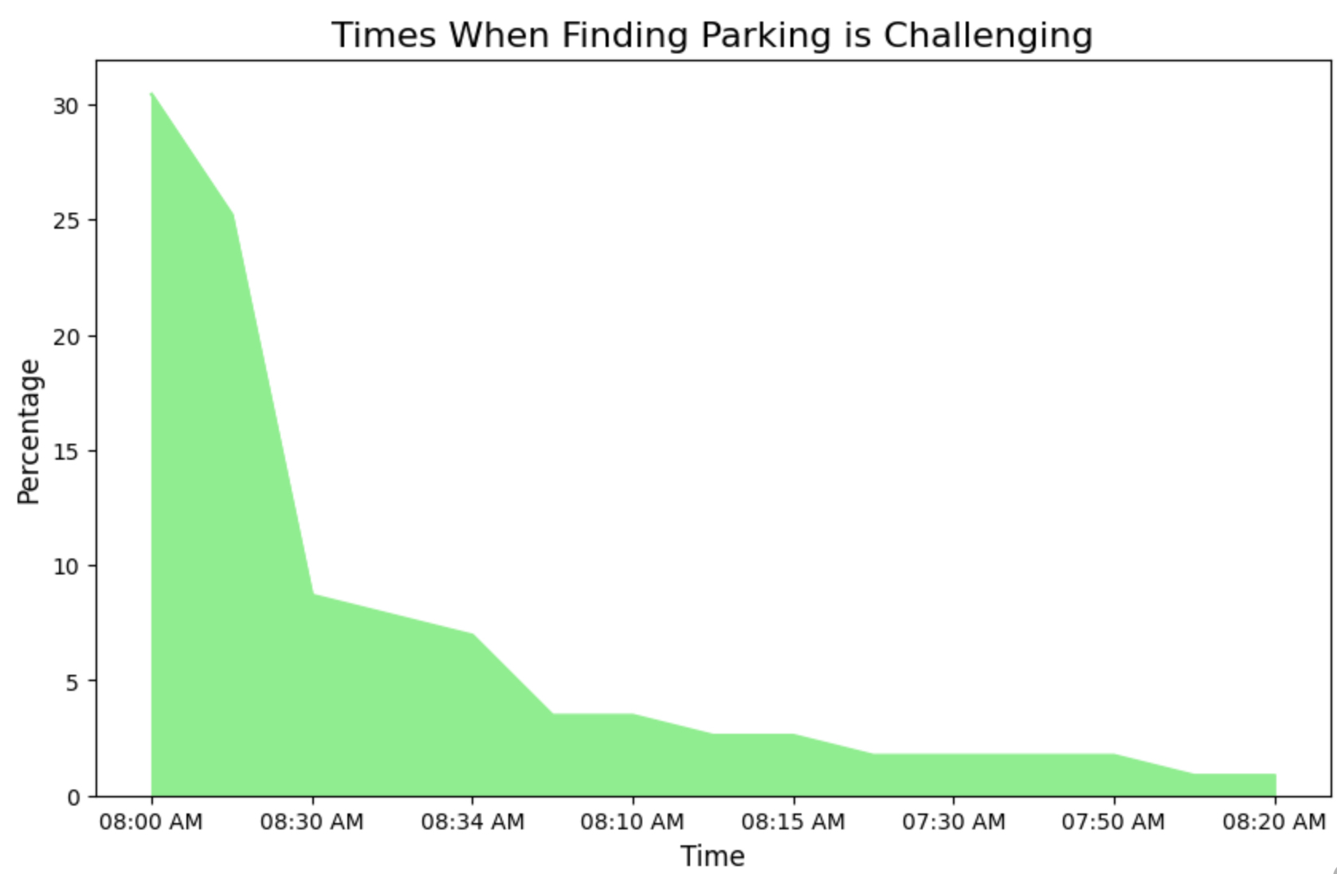
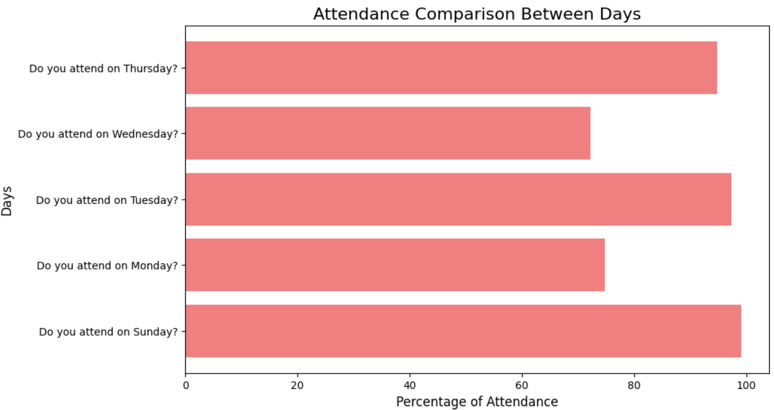
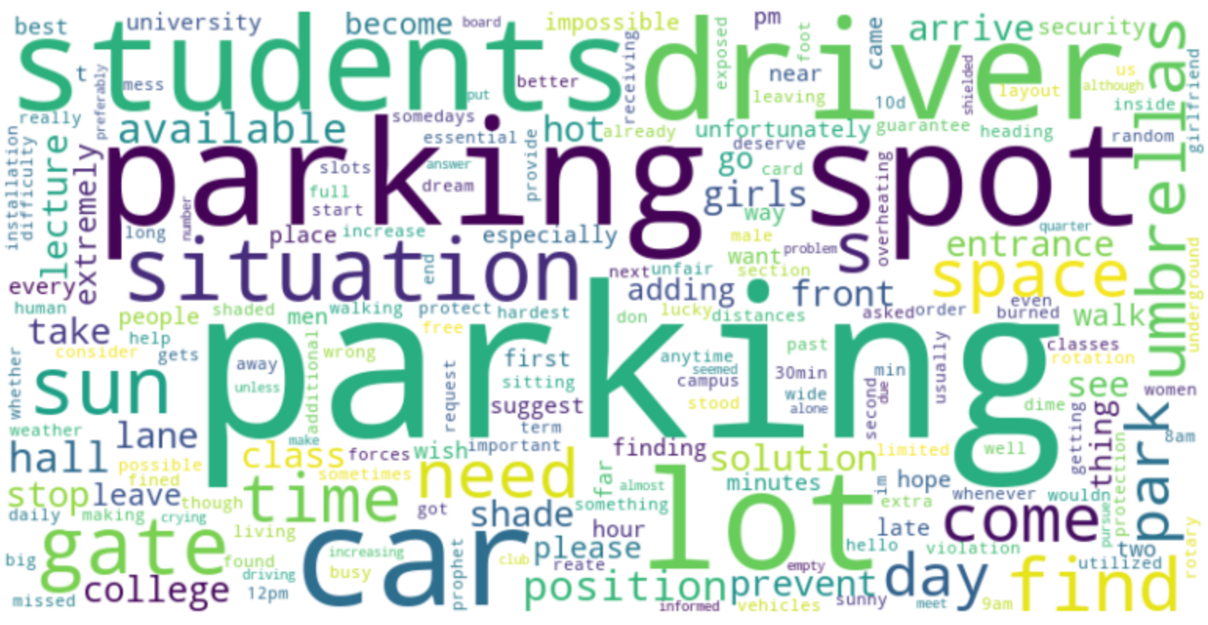
Preliminary Results
Exploring the problem through the survey

Slide 9
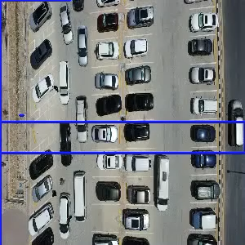
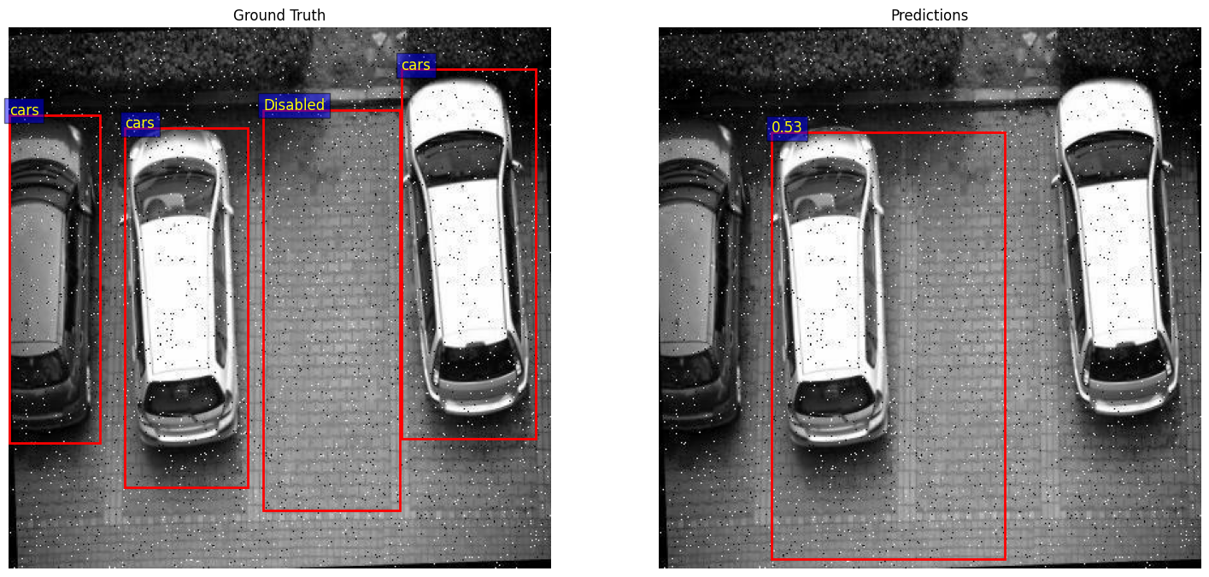
Preliminary Results
Gate3 parking lot videos
The SSD pretrained model was not even close to detecting the cars and empty spaces in our dataset
Evaluating SSD For the CarTopView Dataset: Average Precision: 0.0314.
Average Recall: 0.1352.
Approximate F1 Score: 0.0510

Slide 10
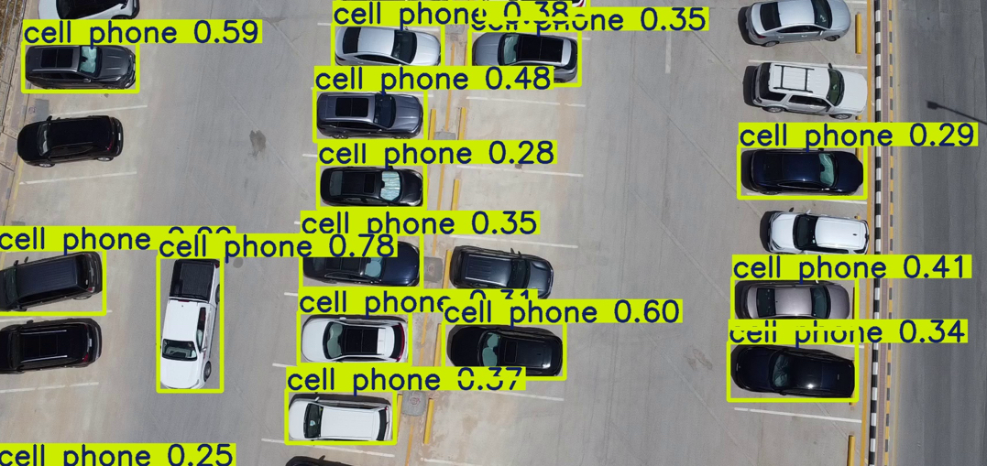
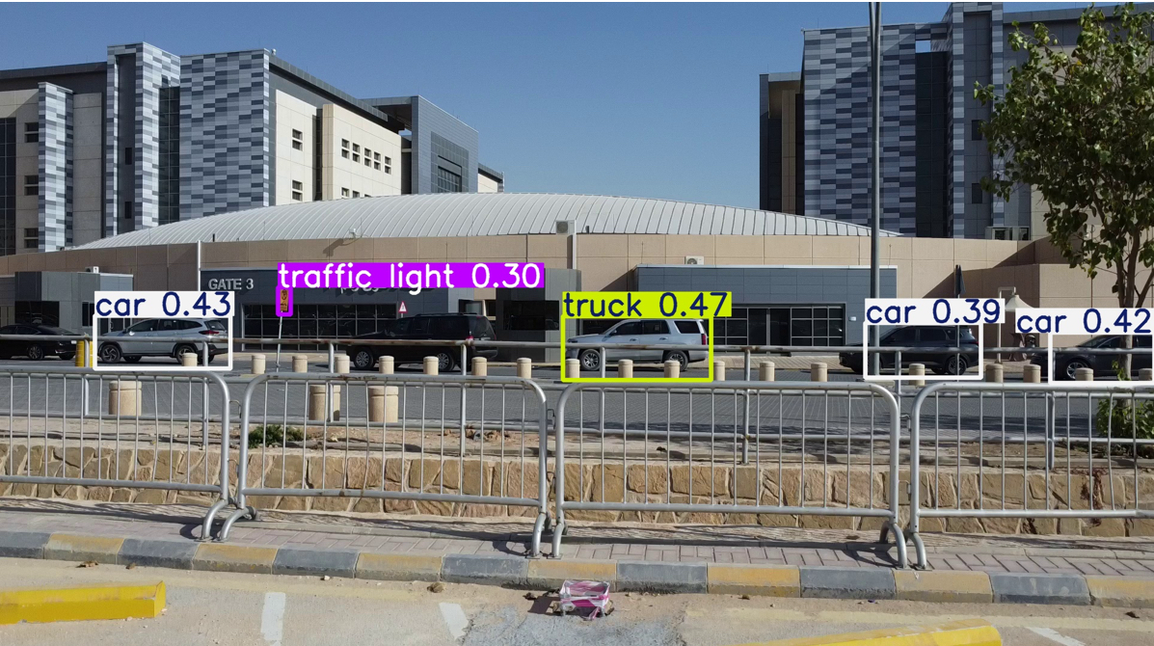
Preliminary Results
Gate3 parking lot videos
- YOLO11v showed more promise, but detected that the cars were cellphones from a top-view
- However, it had no problem detecting cars from a front-view

Slide 11
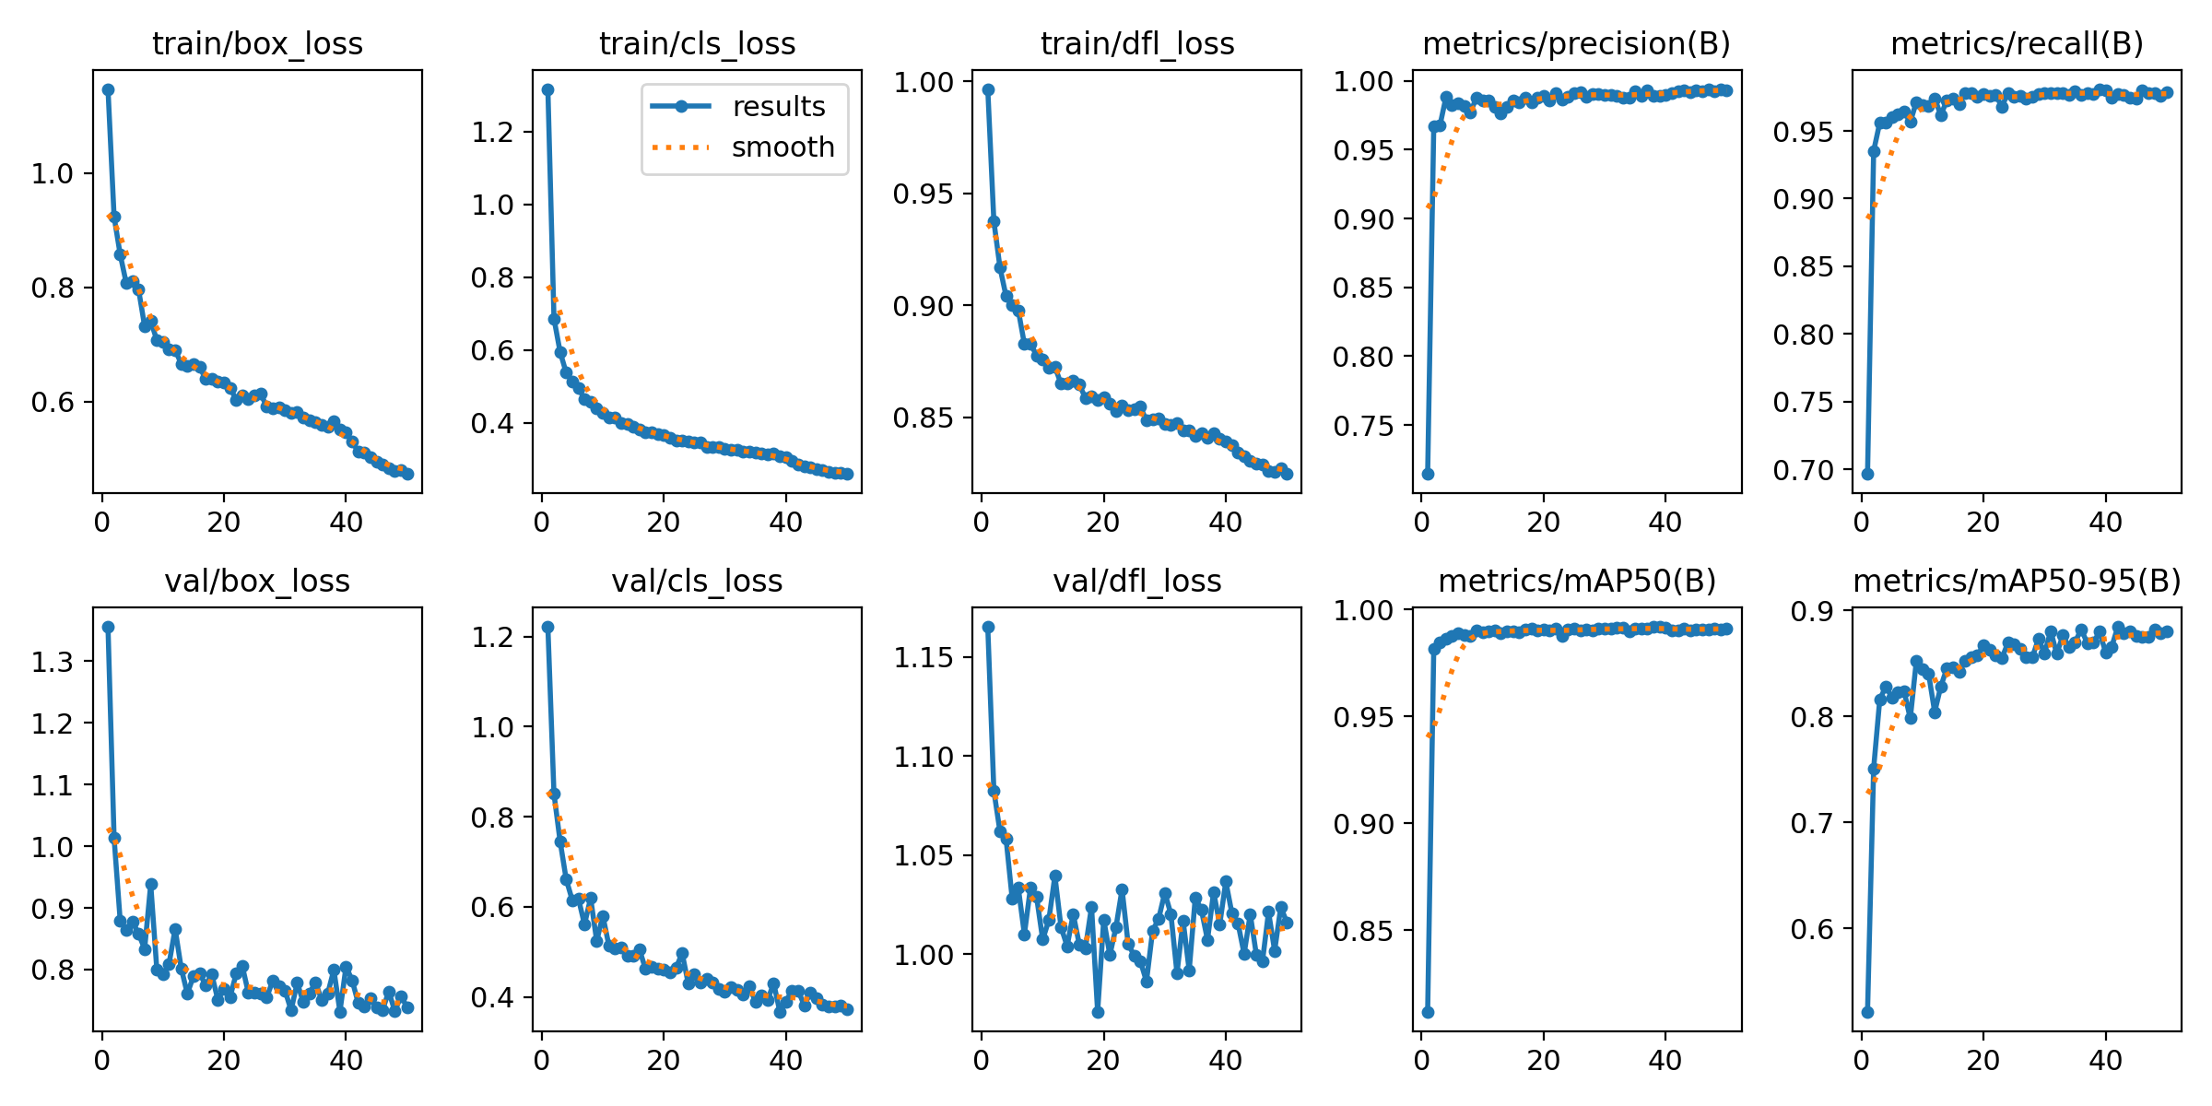
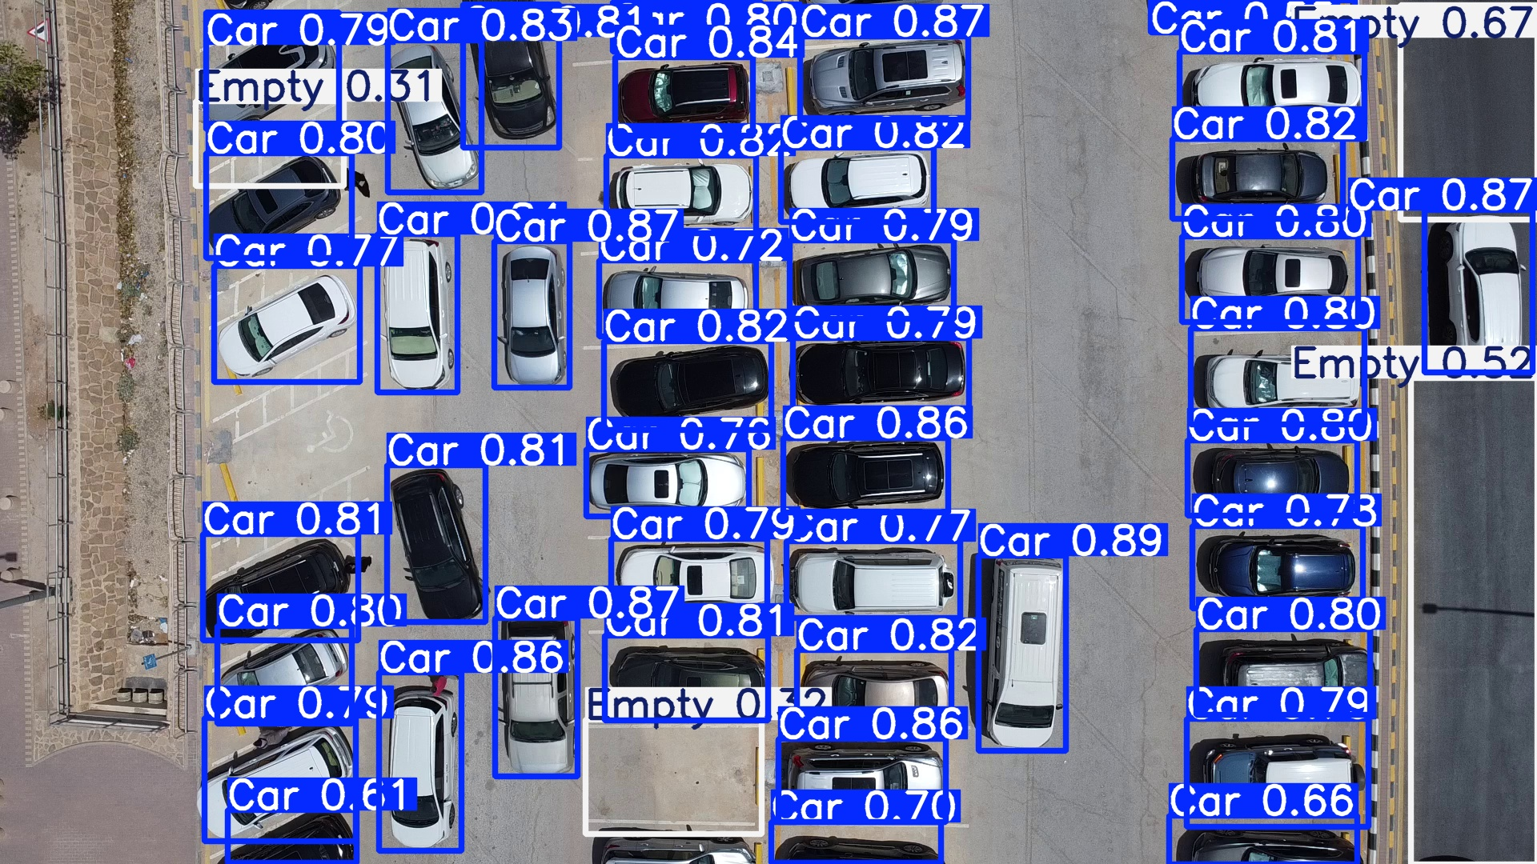
Preliminary Results
CarTopView Dataset
After training YOLO on CarTopView dataset the
best results from grid search:
lr0=0.001 and epochs=50
Confidence = 0.5:
Average Precision: 0.992
Average Recall: 0.961
mAP50: 0.98
mAP50-95: 0.879

Slide 12
Next Steps
After deploying the model, we plan to implement a counting system to show the number of empty and occupied parking lots

Slide 13
Thank you for listening!
Prepared by
Rana Alsayyari 🏎️ | 443200565
Bashair Alsadhan 🚙 | 443200668
Rama Alshebel 🚗 | 443200929
Reema Aljalajel 🚓 | 443201121
Najla Aldakhil 🚕 | 442200142

